Slide 1

Nissan Zero Emission InnEVation
Geo-mapping for Hi-Efficiency Over Spatial Nodes
(The GHOSN Project)
Team:
Steve Pimen, Steve Lemke, Wei Feng, Jonas Broth, Ari Kamlani (Boost)
4/27/2014

Slide 2
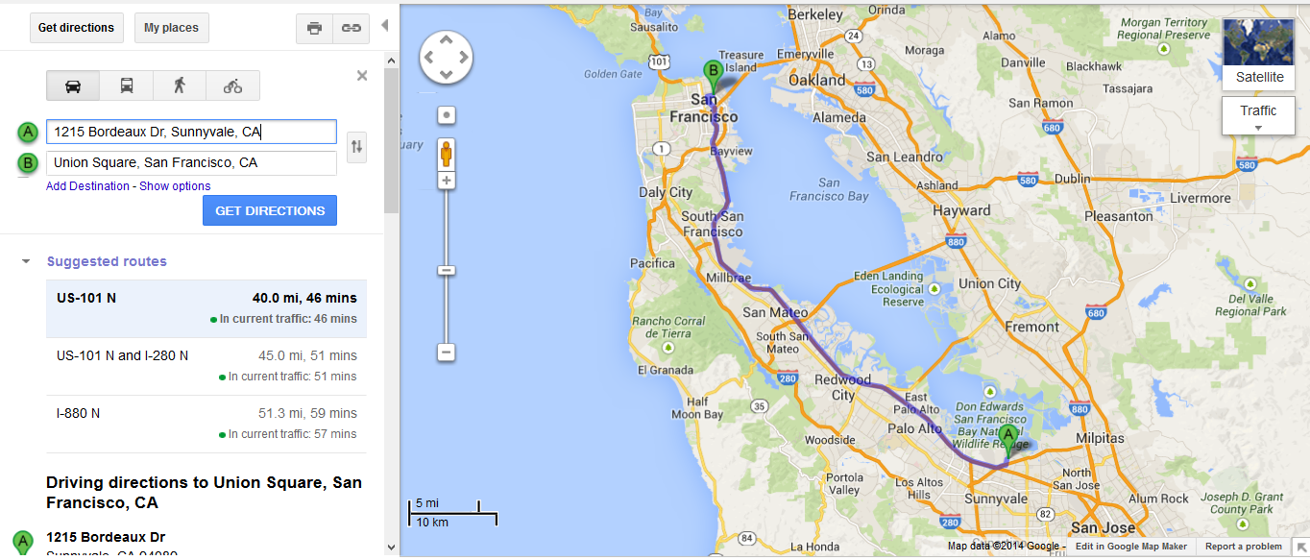
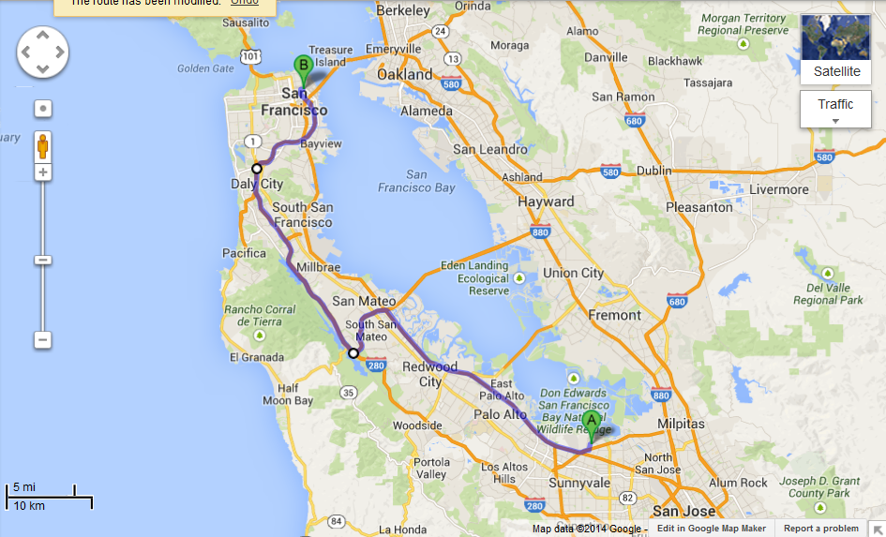
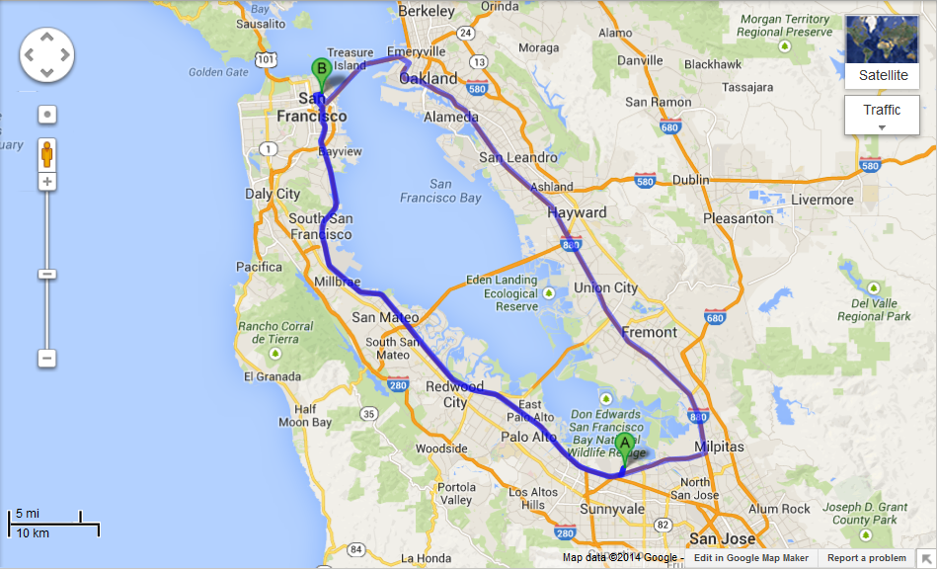
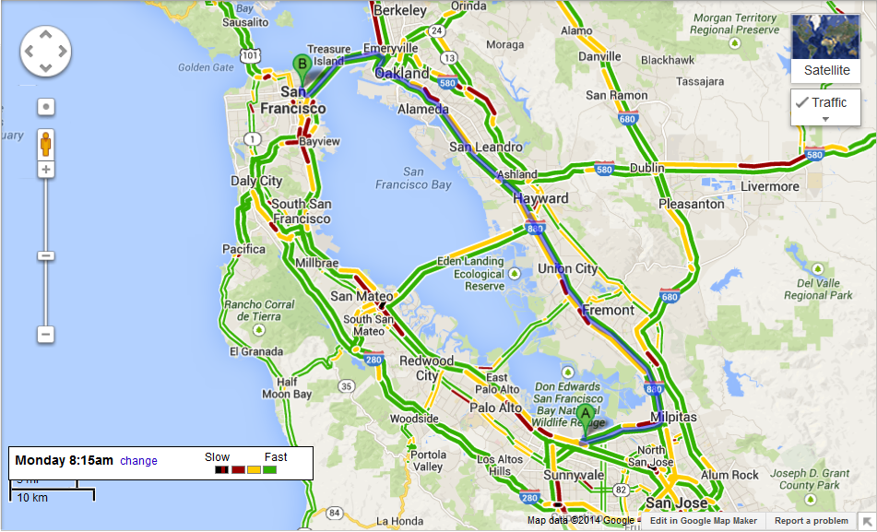
Traffic Based Routing
Shortest, Fastest….
What about most efficient?

Slide 3
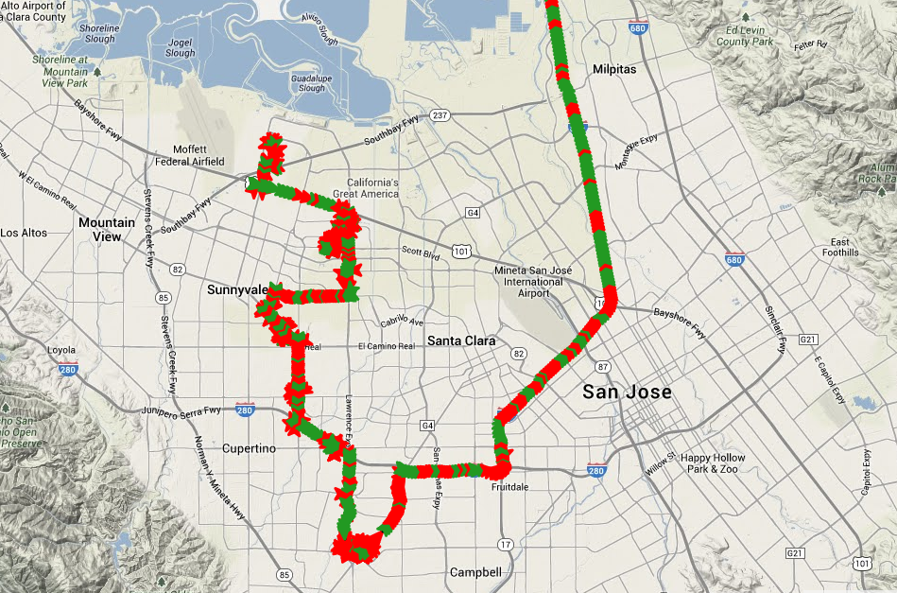
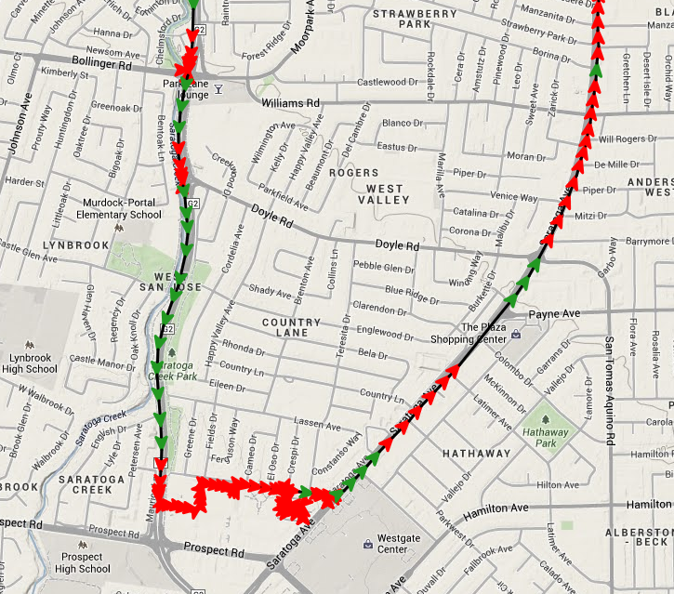
Range Optimized Routing
Notes:
More sophistication, Range Efficiency

Slide 4

Boost / GHOSN
Relevant Project Topics:
Travel Planning
Increase Energy Awareness
Improve Range Confidence
Promote Confident EV Lifestyle
Green House Gas Reduction
Total Cost of Ownership
Prevent/Avoid Charge Rage

Slide 5

Boost / GHOSN
Commercial viability
Crowdsourced – Value Navigation Providers (Waze, Plugshare)
Could be gathered and used by individual drivers
Applicable to traditional ICE vehicles
Market Impact
Range Confidence, Real World Data (not just projections)
Societal Impact
More efficient routes = range confidence = increased EV uptake = GHG reduced = Happy Planet
User Experience
Utilize existing Navigation app
No new interface to learn
Notes:
Valuable to companies like ESRI, Waze, Google…

Slide 6
Boost / GHOSN
Business Case
Of great value to EV drivers
Adding efficiency for ICE vehicles as well
Aggregated from real world drivers
Added value to navigation providers
Google, Waze, Garmin, ESRI, Nissan…
Time to Market
Working prototype

Slide 7
Boost / GHOSN
Range optimized routing.
Real world crowd sourced data provides confidence
Complimentary to existing traffic based routing.
Provides option of “Shortest Route”, “Fastest Route”, “Most Efficient Route”
Working Demo Online:
http://ghosn.github.io

